Slide 1
Upcoming Topic
1.HTML
2.CSS
3.Bootstrap
4.Servlet
5 .JSP
6.JavaScript

Slide 2
HTML
HTML is the standard markup language for creating Web pages.
HTML stands for Hyper Text Markup Language
HTML describes the structure of Web pages using markup
HTML elements are the building blocks of HTML pages
HTML elements are represented by tags

Slide 3
CSS
CSS stands for Cascading Style Sheets
CSS describes how HTML elements are to be displayed on screen, paper, or in other media
CSS saves a lot of work. It can control the layout of multiple web pages all at once
External stylesheets are stored in CSS files

Slide 4
Bootstrap
Bootstrap is the most popular HTML, CSS, and JavaScript framework for developing responsive, mobile-first web sites.

Slide 5
Servlet
Servlet is a technology i.e. used to create web application.
Servlet is an API that provides many interfaces and classes including documentations.
Servlet is an interface that must be implemented for creating any servlet.
Servlet is a class that extend the capabilities of the servers and respond to the incoming request. It can respond to any type of requests.
Servlet is a web component that is deployed on the server to create dynamic web page.

Slide 6
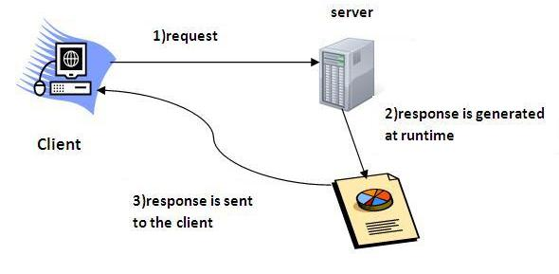
Servlet Architecture

Slide 7
JSP
JSP technology is used to create web application just like Servlet technology. It can be thought of as an extension to servlet because it provides more functionality than servlet such as expression language, jstl etc.
A JSP page consists of HTML tags and JSP tags. The jsp pages are easier to maintain than servlet because we can separate designing and development. It provides some additional features such as Expression Language, Custom Tag etc.

Slide 8
Jsp tags
scriptlet tag
expression tag
declaration tag
directive tag

Slide 9
JAVA SCRIPT
An object-oriented computer programming language commonly used to create interactive effects within web browsers.

